Slide 1

Online Bio-Informatics Toolkit
Cycle 1 Overview
Team 9: Benjamin Williams, Paul Ryu, Ansleigh Yancey, Sadaira Packer,
Mason Monday

Slide 2
System Metaphor
There is a lack of methods that organize genetic variants for diseases, tissues, and cell types. Advanced computational software is needed to create a database that can address these issues.
Our objective is to develop an interactive, online database that is searchable by disease type and/or tissue and cell line.
Users will also be able to request the entry or removal of information in the database.

Slide 3
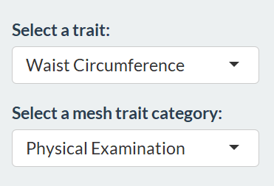

Cycle Intent
Focus in on the searching functionality of our web client
Create meaningful search queries that provide users with desired information
Work on the visual appeal of the application

Slide 4
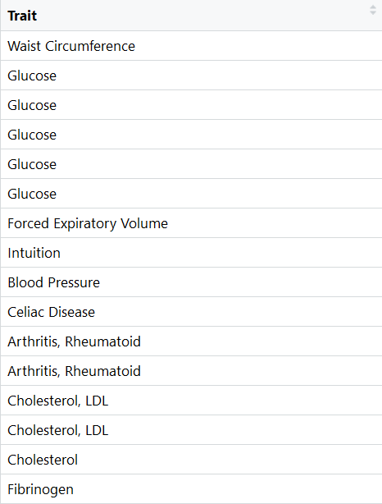
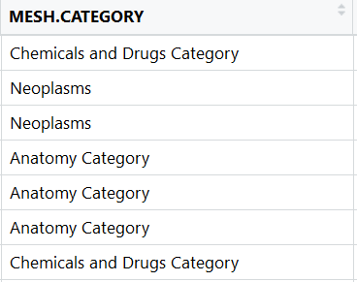
User Stories In Cycle 1
Search for Database Entry (Trait)
Search for Database Entry (Mesh Trait Category)
Search for Database Entry (Trait and Mesh Trait Category)

Slide 5
Research and development
Mesh Traits: Medical Subject Headings (MeSH) is a comprehensive controlled vocabulary for the purpose of categorizing life sciences.
Anatomy [A]
Organisms [B]
Diseases [C]
Chemicals and Drugs [D]
Analytical, Diagnostic and Therapeutic Techniques and Equipment [E]
Psychiatry and Psychology [F]
Biological Sciences [G]
Physical Sciences [H]
etc.

Slide 6
Research and development
Traits: most human genetic traits are the product of interactions between several genes
every one of us has a unique combination of traits, but patterns of traits can offer firm evidence that a disease transmitted from parent to child is linked to one or more genes.
Study of traits provides clues about which chromosome contains the gene and precisely where the gene lies on that chromosome.

Slide 7
Lessons Learned
Paul:
Sometimes there’s nothing that a group can do if there is not enough information given by the client.
Sadaira
Looking at other cell line databases wasn’t very helpful in helping us combine the datasets.
There being multiple cell lines for some of the dataset entries will complicate the search algorithm.
Ben
Clearly define end goal when making changes to application
Communicate more with team members when struggling with code
Mason
Testing certain functionalities without necessary data
Communicating with a sponsor about retrieving necessary data
Ansleigh
Shiny has more than one page layout capability. Different page packages are useful for different web applications.
Sponsor communication is vital.

